Slide 1

Corporate Governance Evaluation: Data Reporting & Analysis Of Companies Across Europe

Slide 2
Board Evaluation Analysis
For Financial Companies

Slide 3
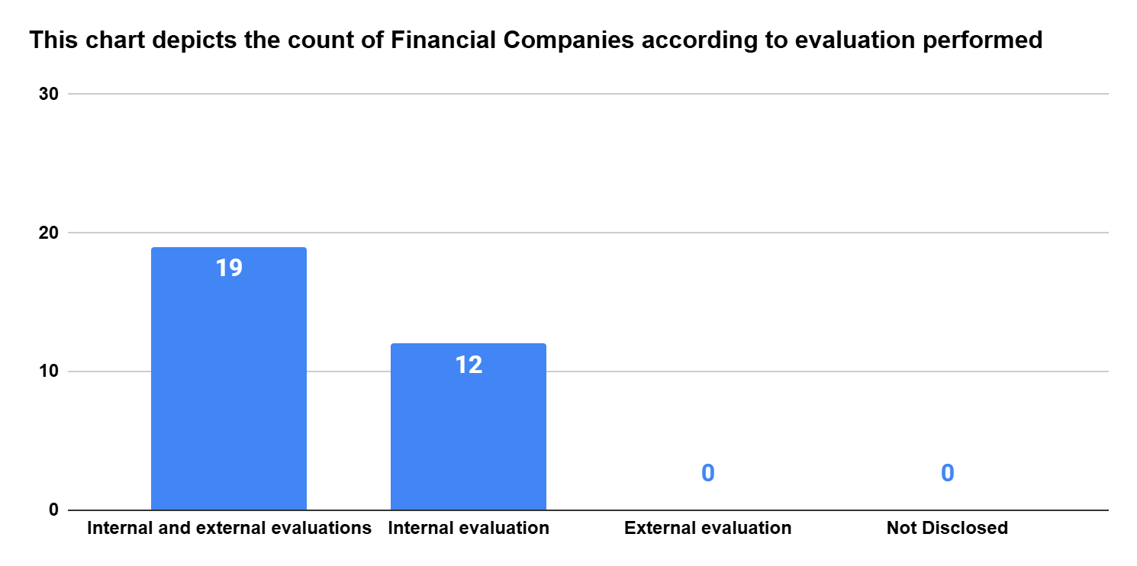
Board Evaluation Analysis For Financial Companies
Notes:
What was done:
An analysis was conducted to assess the evaluation practices of financial companies, specifically focusing on whether they perform internal evaluations, external evaluations, or both. Based on the disclosures available in public documents such as annual reports, each company was classified into one of four categories: those conducting both internal and external evaluations, those conducting only internal evaluations, those conducting only external evaluations, and those that did not disclose any evaluation practice. The results were then summarized using a bar chart to visually represent the count of companies in each category.
Sample used:
The dataset consisted of 31 financial companies. The data reveals that 19 companies reported performing both internal and external evaluations, while 12 companies reported only internal evaluations. No companies were found to perform only external evaluations or fall under the "Not Disclosed" category, as reflected in the chart.
Assumptions made:
It was assumed that each company fits into only one category and there is no overlap across categories. In other words, a company counted under "internal and external evaluations" was not also counted under the individual categories.
We also assumed that the terms "internal evaluation" and "external evaluation" were used consistently across all company disclosures and carry comparable meaning for the purpose of this classification.
In cases where a company did not disclose any information regarding their evaluation practices, we assumed that such evaluations were either not conducted or not publicly reported, and therefore placed them under the "Not Disclosed" category.
Additionally, if a company disclosed only one type of evaluation—either internal or external—we assumed that the company performs only the evaluation type mentioned in their annual report. For example, if a company disclosed internal evaluation but made no mention of external evaluation, we treated it as conducting only internal evaluation. The same logic was applied in reverse.

Slide 4
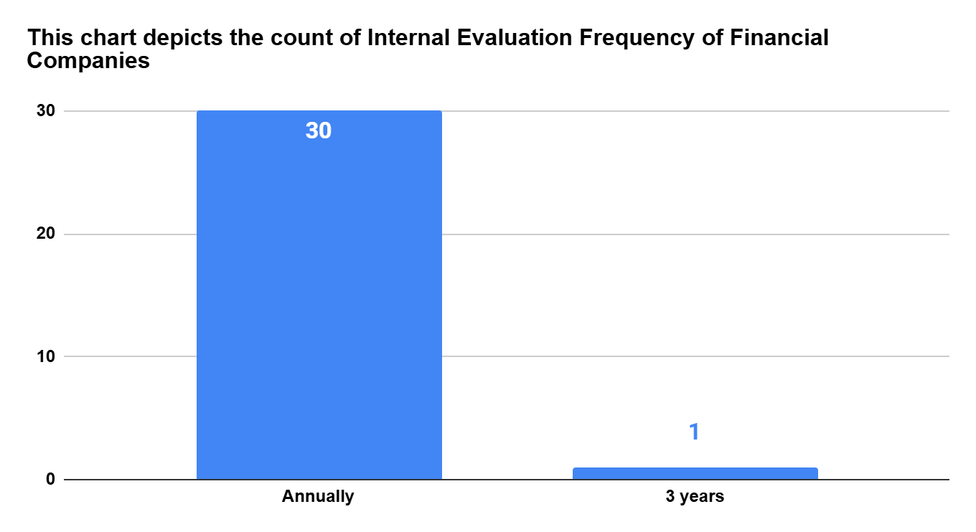
Board Evaluation Analysis For Financial Companies
Notes:
What was done:
An analysis was conducted to understand the frequency of internal evaluations conducted by financial companies. The companies were categorized based on whether they reported conducting internal evaluations annually or once every three years. The resulting distribution was visualized using a bar chart.
Sample used:
We sampled a dataset containing 31 financial companies. Within this dataset, we observed that 30 companies conduct internal evaluations on an annual basis, while only one company—KBC Group NV—reported conducting internal evaluations every three years.
Assumptions made:
In cases where a company disclosed multiple frequencies (e.g., evaluations at different levels with varying periodicity), we assumed the most frequent and organization-wide frequency as the representative one for classification.
If a company mentioned "annual reviews" without explicitly labeling them as formal internal evaluations, we assumed they qualified as internal evaluations if the description suggested a structured, systematic process.

Slide 5
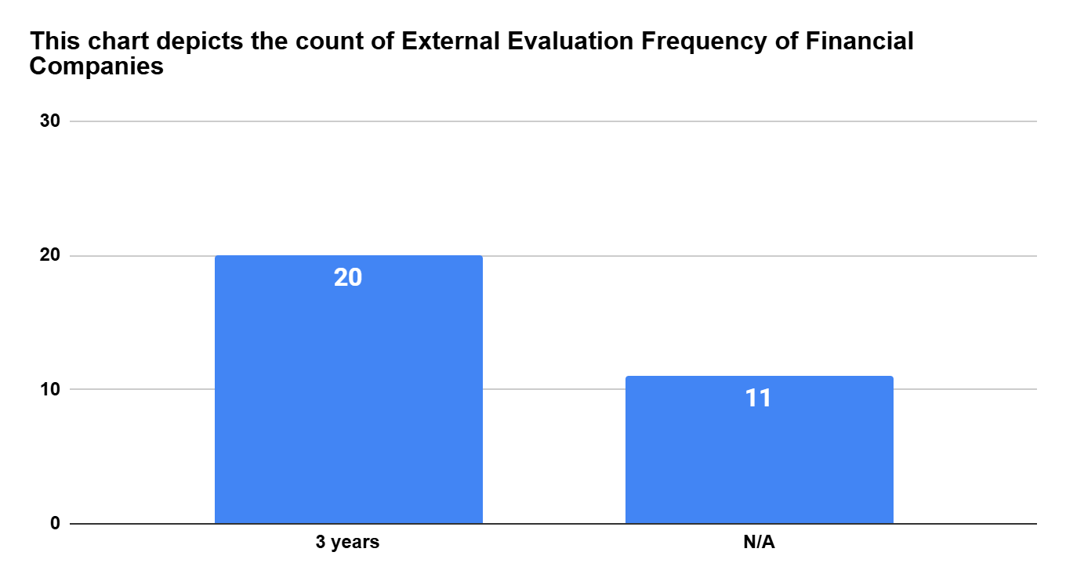
Board Evaluation Analysis For Financial Companies
Notes:
What was done:
We analyzed the frequency of external board evaluations conducted by financial companies. Based on the dataset, we categorized companies by whether they conduct evaluations every three years or did not disclose the frequency.
Sample used:
We observed the dataset containing 31 financial companies and found that 20 companies reported performing external evaluations every three years, whereas 11 companies did not disclose the frequency of their external evaluations.
Assumptions made:
It was assumed that the disclosures made by companies accurately represent their external evaluation practices.
For companies that did not disclose any frequency (categorized as N/A), we assumed they either do not conduct evaluations on a fixed schedule or chose not to report this information. No further inferences were made for these cases.
If a company provided unclear descriptors like “as needed” or “periodically,” and no clear timeline (such as “every 3 years”) was mentioned, we included them under the N/A category.

Slide 6
Board Evaluation Analysis
For Non-Financial Companies

Slide 7
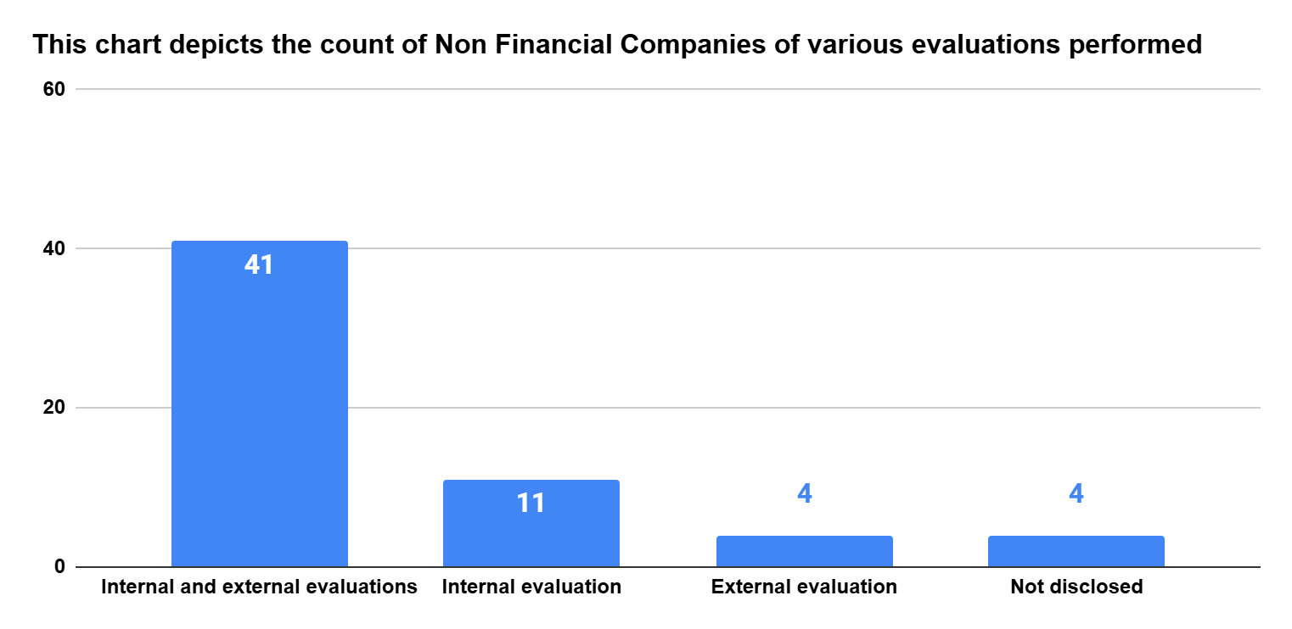
Board Evaluation Analysis For Non - Financial Companies
Notes:
What was done:
We analyzed the types of board evaluations conducted by non-financial companies. Based on the dataset, companies were categorized according to whether they performed internal evaluations, external evaluations, both, or did not disclose any information.
Sample used:
We analyzed a dataset consisting of 60 non-financial companies. Out of these, 41 companies conducted both internal and external evaluations, 11 companies conducted only internal evaluations, 4 companies conducted only external evaluations, and 4 companies did not disclose the type of evaluation performed.
Assumptions made:
We assumed that the information disclosed in annual reports or other official documents accurately represents the board evaluation practices of each company.
In cases where companies mentioned only one type of evaluation (either internal or external), we assumed they only conducted that type, and not the other, unless explicitly mentioned.
For companies that did not disclose any information, we made no assumptions about whether evaluations were conducted and placed them under the “Not disclosed” category.
It was assumed that each company fits into only one category and there is no overlap across categories. In other words, a company counted under "internal and external evaluations" was not also counted under the individual categories.

Slide 8
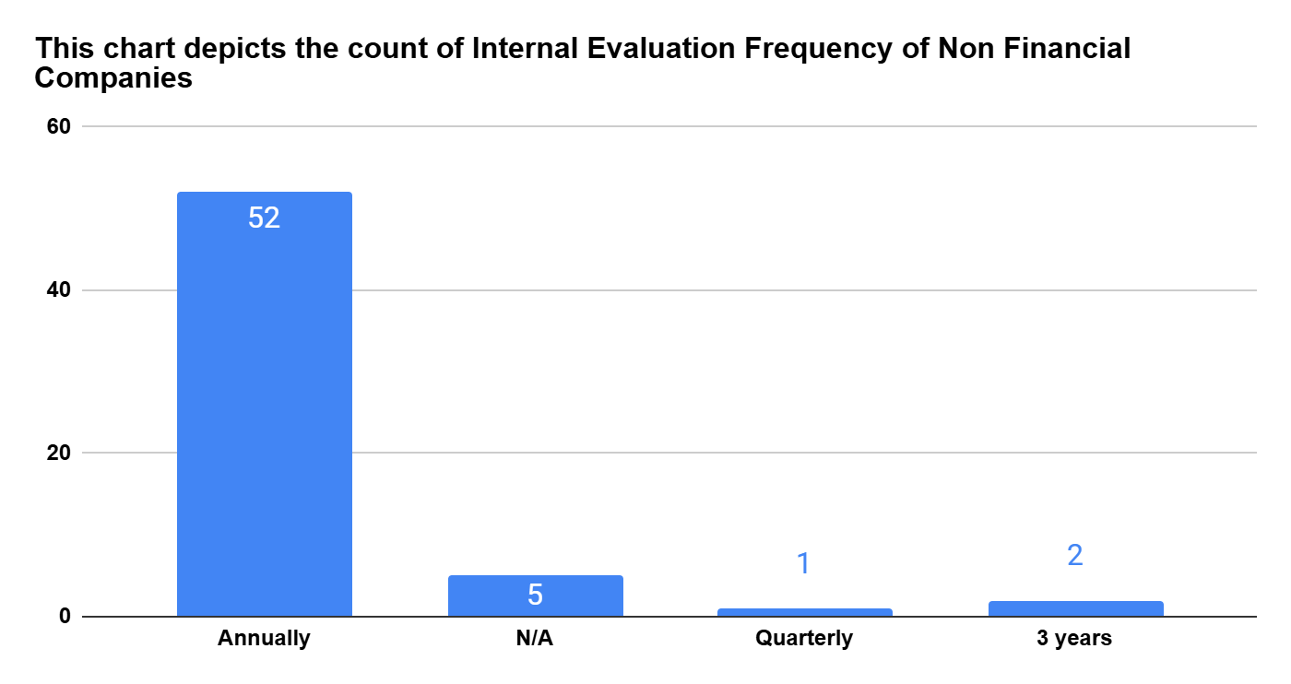
Board Evaluation Analysis For Non - Financial Companies
Notes:
What was done:
We analyzed the frequency at which non-financial companies in our dataset reported conducting internal evaluations. The "Internal Evaluation Frequency" for each company was examined, and the companies were then grouped and counted based on the reported frequency: Annually, Quarterly, every 3 years, or Not Applicable (N/A).
Sample used:
We analyzed a dataset consisting of 60 non-financial companies across various sectors from several European countries. For this specific analysis, we focused on the "Internal Evaluation Frequency" reported by each of these companies. The distribution of reported frequencies within this sample is as follows: 52 companies reported conducting internal evaluations annually, 1 company quarterly, 2 company every 3 years, and 5 companies indicated "N/A."
Assumptions made:
We assumed that the frequency of internal evaluations reported by each company in the dataset accurately reflects their actual practices.
For the 5 companies that reported "N/A" for their internal evaluation frequency, we did not make any assumptions about whether they conduct internal evaluations. This response was treated as a distinct category indicating a lack of applicable information or a decision not to disclose the frequency.
We also assumed that the categorization of internal evaluation frequencies (Annually, Quarterly, 3 years) provided in the dataset was consistently understood and applied by the reporting companies.

Slide 9
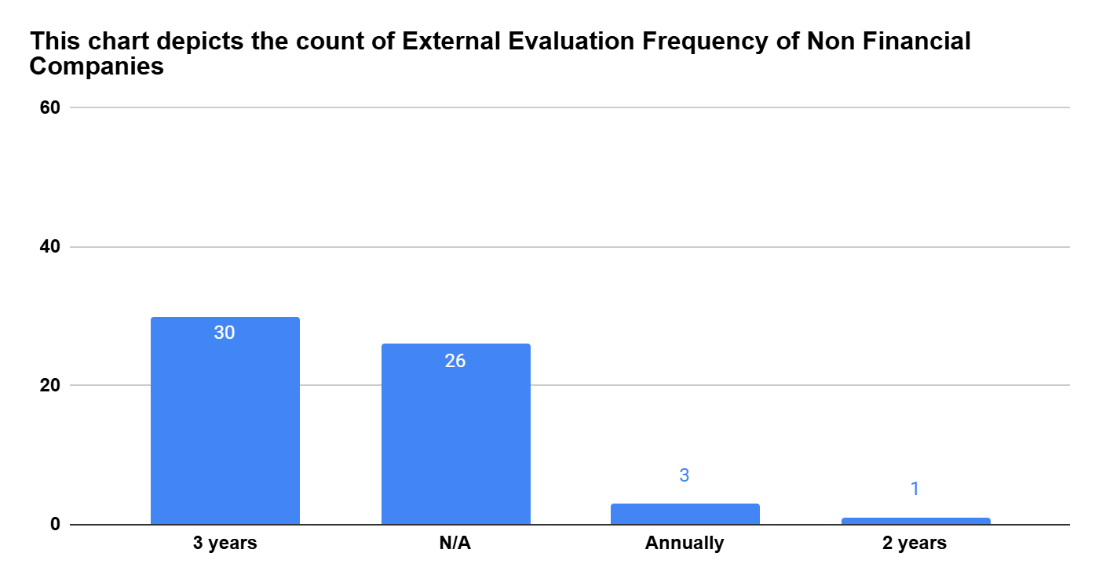
Board Evaluation Analysis For Non - Financial Companies
Notes:
What was done:
We analyzed how frequently the non-financial companies in our dataset conduct external board evaluations. Based on the information provided, we grouped the companies by their reported frequency: every three years, annually, every two years, or if the frequency was not disclosed (N/A).
Sample used:
We examined our dataset of 60 non-financial companies. We found that 30 companies reported conducting external evaluations every three years, 3 companies reported doing so annually, and 1 company reported a frequency of every two years. A significant number, 2 companies, did not disclose the frequency of their external evaluations and were categorized as N/A.
Assumptions made:
It was assumed that the information provided by the companies accurately reflects their practices regarding the frequency of external board evaluations.
For the companies that did not disclose their evaluation frequency (categorized as N/A), we assumed they either do not conduct external evaluations on a fixed schedule or chose not to report this information. We did not make any further inferences about their specific practices.

Slide 10
Board Evaluation Analysis
For Euro Stoxx 50 Companies

Slide 11
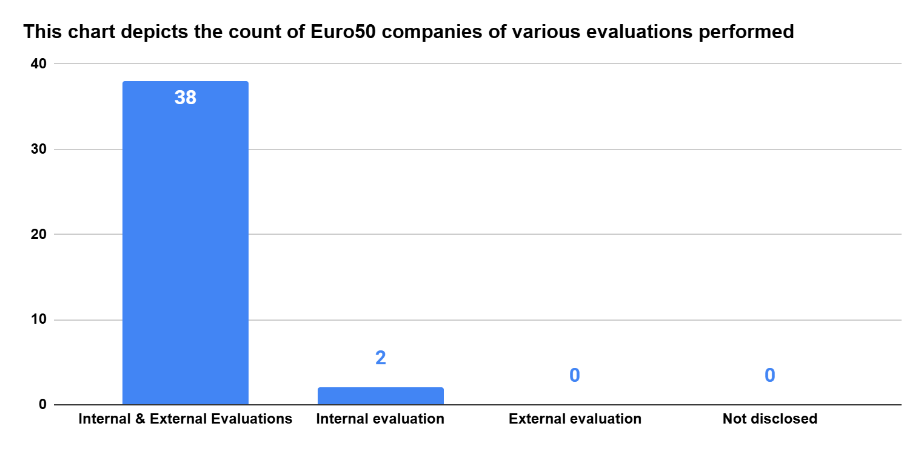
Board Evaluation Analysis For Euro Stoxx 50 Companies
Notes:
What was done:
We analyzed the types of board evaluations conducted by companies listed in the Euro Stoxx 50 index. Based on the dataset, we categorized these companies into four groups: those performing both internal and external evaluations, those performing only internal evaluations, those performing only external evaluations, and those for whom the type of evaluation was not disclosed.
Sample used:
We examined a dataset consisting of companies within the Euro Stoxx 50 index. Our analysis revealed that 38 companies reported conducting both internal and external board evaluations. Additionally, 2 companies reported conducting only internal evaluations. Notably, no companies in our sample disclosed performing only external evaluations, and no companies fell into the "Not disclosed" category for the type of evaluation performed.
Assumptions made:
We assumed that the information disclosed by these Euro Stoxx 50 companies accurately reflects the types of board evaluations they conduct.
In cases where companies explicitly stated they performed "Internal & External Evaluations" or "Internal evaluation," we took this as their primary method. We assumed that if a company only mentioned one type, they did not regularly conduct the other type unless explicitly stated elsewhere in their disclosures.
We also assumed that the four categories used for analysis (Both Internal & External Evaluations, Internal Evaluation, External Evaluation, and Not disclosed) are mutually exclusive, meaning each company could only be classified into one of these groups based on their reported practices.

Slide 12
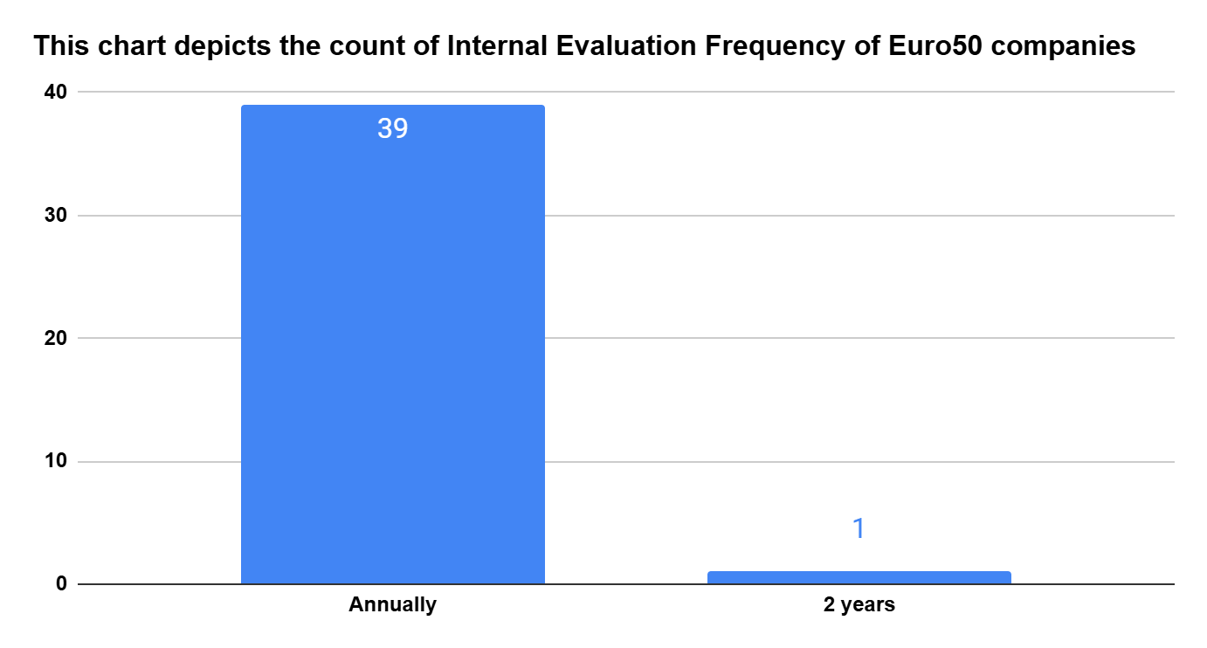
Board Evaluation Analysis For Euro Stoxx 50 Companies
Notes:
What was done:
We analyzed the frequency at which companies within the Euro Stoxx 50 index reported conducting internal evaluations. The "Internal Evaluation Frequency" for each company was examined, and the companies were grouped and counted based on the reported frequencies.
Sample used:
We examined a dataset consisting of companies in the Euro Stoxx 50 index. Our analysis showed that 39 companies reported conducting internal evaluations annually, while 1 company, specifically Volkswagen, reported a frequency of every 2 years. No other frequencies for internal evaluations were reported by the companies in this sample.
Assumptions made:
We assumed that the frequency of internal evaluations reported by each company in the dataset accurately reflects their actual practices.
We also assumed that the categorization of internal evaluation frequencies (Annually, 2 years) provided in the dataset was consistently understood and applied by the reporting companies.

Slide 13
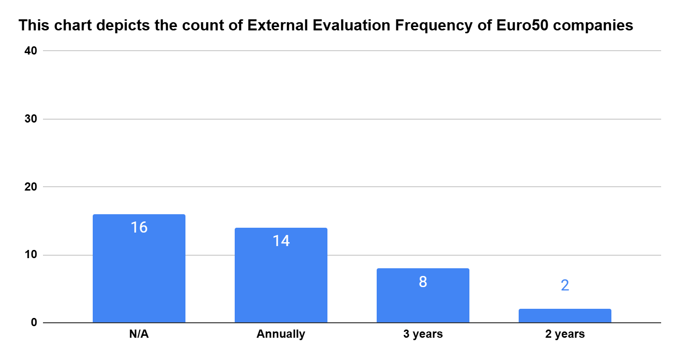
Board Evaluation Analysis For Euro Stoxx 50 Companies
Notes:
What was done:
We analyzed the frequency at which companies within the Euro Stoxx 50 index reported conducting external evaluations. The "External Evaluation Frequency" for each company was examined, and the companies were grouped and counted based on the reported frequencies.
Sample used:
We examined a dataset consisting of companies in the Euro Stoxx 50 index. Our analysis showed that for 16 companies, the external evaluation frequency was Not Applicable (N/A). 14 companies reported conducting external evaluations annually, 8 companies reported a frequency of every 3 years, and 2 companies reported a frequency of every 2 years.
Assumptions made:
We assumed that the frequency of external evaluations reported by each company in the dataset accurately reflects their actual practices.
For the 16 companies that reported "N/A" for their external evaluation frequency, we did not make any assumptions about whether they conduct external evaluations. This response was treated as a distinct category indicating a lack of applicable information or a decision not to disclose the frequency.

Slide 14
Board Competencies Analysis

Slide 15
Competency Benchmarking
Leadership & Governance | Finance & Accounting | Strategy & M&A | Technology & Digital | Legal & Compliance | Sustainability & ESG | HR & People | Industry Expertise | Innovation & R&D | Marketing & Sales | International & Operations | Risk & Audit | Others
Leadership experience | Finance | Strategy | Digitalization | Legal | Sustainability | Human resources | Automotive industry | Innovation | Marketing | International experience | Risk management | Public affairs
Governance | Accounting | M&A | IT | Compliance | ESG | Talent management | Energy industry | R&D | Sales | Global market experience | Audit | Academia
Boardroom experience | Financial reporting | Corporate strategy | AI | Corporate governance | Climate change | HR/Diversity | FMCG/Food & Beverage | Product development | Customer experience | Overseas experience | Internal control | Remuneration systems
P&L responsibility | Capital markets | Transformation | Cybersecurity | Regulatory | Environmental responsibility | Leadership development | Telecoms | Research | Brand management | Business operations | Financial controls | Communications
CEO experience | Investment banking | Business transformation | Information security | Law | Social sustainability | People & culture | Pharmaceuticals | Innovation management | Customer-consumer focus | Procurement/supply chain | Governance controls | Ethics
General management | Controlling | Capital allocation | Technology strategy | Public policy | CSR | Employee matters | Construction | Engineering innovation | Business development | Company knowledge | Financial expert | Media
Corporate management | Financial strategy | Corporate transactions | Software | Statutory reporting | Social responsibility | Human capital | Mining | Tech innovation | Communications | International business | Auditing | Education
Senior executive roles | Portfolio management | Change management | Digital business models | Risk & regulation | Decarbonisation | HR systems | Retail | Material sciences | Digital marketing | International markets | Crisis handling | Geopolitics

Slide 16
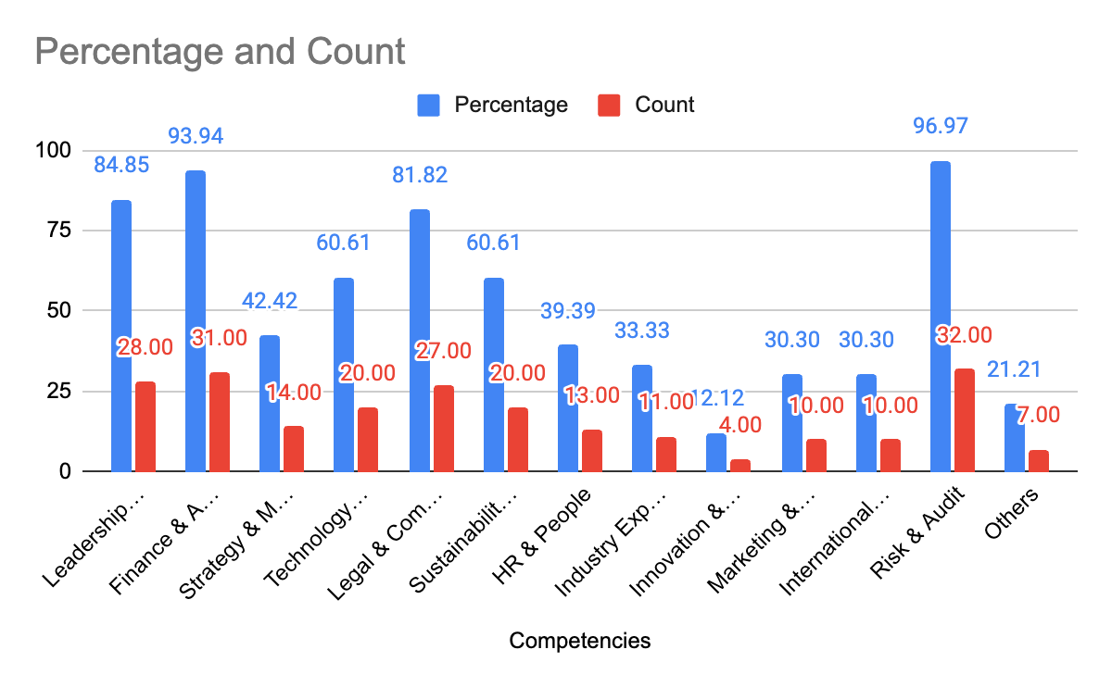
Board Competencies
Financial Competencies
Notes:
What Was Done
A comprehensive benchmarking study was conducted to evaluate the competencies present in the boards of financial companies. The team categorized a wide range of board-level skills and experiences into 13 standard competency domains such as Leadership & Governance, Finance & Accounting, Risk & Audit, and so on. Each company’s board profile was then analyzed to determine whether a given competency was present (coded as 1) or absent (coded as 0). These individual indicators were aggregated to compute the total count and percentage of companies demonstrating strength in each domain. The resulting visualization displays both the percentage of companies possessing a given competency (in blue) and the absolute number (in red).
Sample Used
The analysis was specifically focused on financial sector companies, though the exact number of companies analyzed is not explicitly mentioned in the chart itself. From the highest count bar (Risk & Audit with 31), it can be inferred that around 33 financial companies may have been assessed (since 93.94% = 31 out of ~33). These companies’ board member profiles were likely sourced from publicly available data such as annual reports, company websites, or board disclosures, and were manually coded based on the presence of the listed competencies across board members.
Assumptions Made
Key assumptions made in the benchmarking process include: (1) the presence of a competency in at least one board member qualifies the company as possessing that competency; (2) all competencies listed under a category (e.g., "Risk management", "Internal control", "Audit" under Risk & Audit) are weighted equally; (3) binary coding (0/1) is sufficient to capture the presence or absence of competencies without considering depth, expertise level, or years of experience; and (4) company self-disclosures or bios accurately reflect the full scope of director competencies. Additionally, it is assumed that these competencies are relevant and material to the effectiveness of board governance in financial institutions.

Slide 17
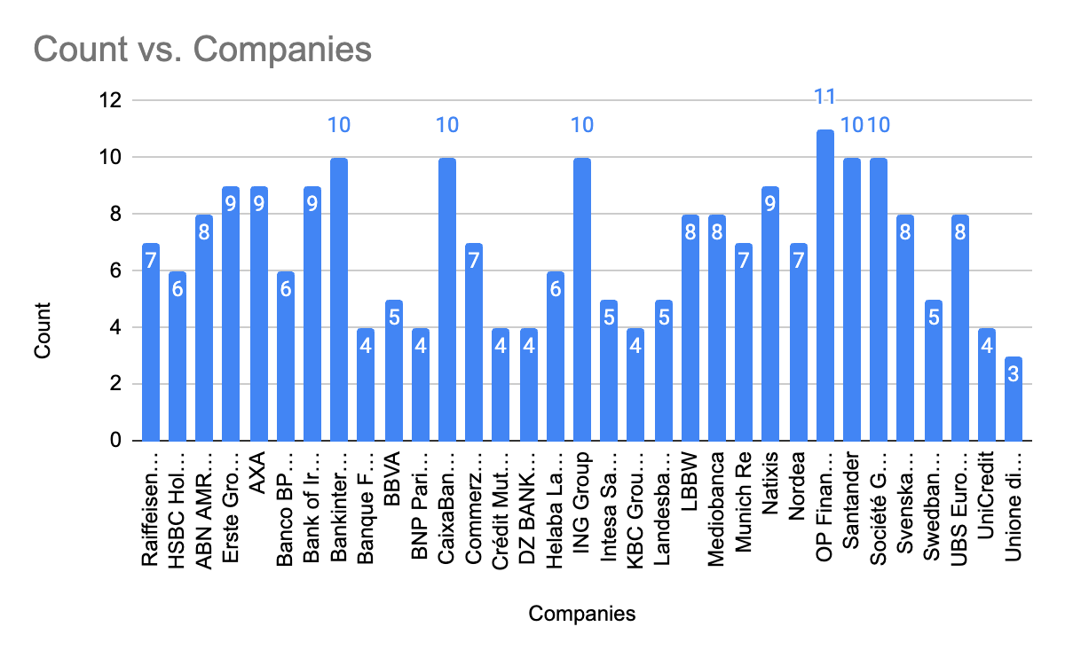
Board Competencies
Financial Competencies
Notes:
What was done
The analysis aimed to benchmark the presence of key competencies across the boards of leading European financial institutions. A framework of 13 relevant competencies—such as Risk & Audit, Finance & Accounting, Technology, ESG, and Governance—was developed to evaluate each company. Publicly available board member profiles were reviewed, and each company was assigned a binary score for each competency based on whether at least one board member demonstrated relevant expertise. The aggregated data was visualized to show both the percentage of companies possessing each competency and the total number of competencies represented within individual companies.
Sample Used
The chart complements this analysis by showing the count of competencies identified for each of the 33 financial companies studied. Major institutions such as HSBC Holdings, AXA, BNP Paribas, UBS, and Commerzbank AG were included, offering a well-rounded view of board-level expertise across Europe’s financial sector. This chart enables a company-level comparison, helping to highlight which institutions have more comprehensive board coverage in terms of strategic and operational competencies.
Assumptions Made
Several assumptions underpinned this analysis. First, the binary scoring method implies that the presence of even one board member with a particular skill set qualifies the entire company as possessing that competency—potentially oversimplifying the depth or distribution of expertise. Additionally, all competencies were weighted equally despite varying relevance depending on the business model. Lastly, the evaluation relied solely on public data, assuming consistency in how profiles were reported and interpreted, and applied a standardized taxonomy across diverse firms within the financial industry.

Slide 18
Board Competencies
All Non Financial Competencies
Notes:
What Was Done
For analyzing Non-Financial Competencies, a similar approach was used as with financial competencies. The objective was to assess the presence of diverse non-financial expertise across company boards, focusing on competencies such as Leadership & Governance, Technology & Digital, Sustainability & ESG, HR & People, Legal & Compliance, and others. Each board was reviewed to identify whether it included at least one member possessing each of these competencies. A binary scoring system was applied, assigning a score of 1 if the competency was present (i.e., if at least one board member had relevant background), and 0 if it was absent. The cumulative data was then used to derive the total count and percentage of companies with each competency, which was subsequently visualized through a bar graph.
Sample Used
The sample used for this analysis comprised a diverse group of non-financial companies. These were selected from a relevant benchmark index or a curated list of large, publicly listed firms representing various sectors such as manufacturing, services, retail, infrastructure, etc. The information was primarily drawn from publicly available board profiles, corporate governance reports, annual filings, and company websites. This ensured consistency and transparency in the data-gathering process across all companies considered.
Assumptions Made
Several assumptions were made to enable this analysis. Firstly, all competencies were treated with equal weight, without adjusting for their relative importance across different industries. Secondly, the evaluation was limited to whether at least one board member possessed a given competency, without accounting for the number of members or the depth of expertise. Thirdly, only publicly disclosed data was used, which may not fully reflect informal or emerging areas of board expertise. Despite these limitations, the analysis provides a valuable snapshot of the current landscape of non-financial competencies present on company boards.

Slide 19
Board Competencies
All Non Financial Competencies
Notes:
What was done.
To assess competency coverage at the company level for non-financial firms, a detailed count of how many distinct board-level competencies each company possesses was carried out. The process involved mapping the disclosed expertise of board members against a standardized list of non-financial competencies—such as Leadership & Governance, Strategy & M&A, Technology & Digital, ESG, HR & People, etc.—previously defined in the benchmarking framework. For each company, a count was recorded based on how many of these distinct competencies were present among its board members. This enabled us to measure the breadth of board skillsets and understand how comprehensively boards are equipped to handle evolving business environments.
Sample Used
The sample consisted of 100 non-financial companies spanning various sectors such as consumer goods, manufacturing, telecom, utilities, pharmaceuticals, and energy. These companies were selected from among the largest listed firms across multiple geographies, ensuring regional diversity and sectoral representation. They include globally recognized entities such as Nestlé, Siemens, L'Oréal, SAP, Vodafone, and BP, among others. Data was sourced from publicly available corporate governance reports, annual filings, and official board biographies. Only companies with full board data accessible in English or with credible translated sources were included in the final sample to ensure data reliability.
Assumptions Made
A few critical assumptions underpinned this analysis to ensure comparability across companies. First, each unique competency was counted only once per company, regardless of how many board members held it, thus emphasizing breadth over redundancy. Second, the competency framework used to evaluate the board composition was kept consistent across all companies and aligned with global best practices in governance benchmarking. Third, we assumed that publicly disclosed expertise accurately reflects actual board skillsets and that any omissions in disclosure were not competency-related. This provided a robust basis to benchmark how many strategic areas each board effectively covers, aiding in identifying leaders and laggards in governance diversity.

Slide 20
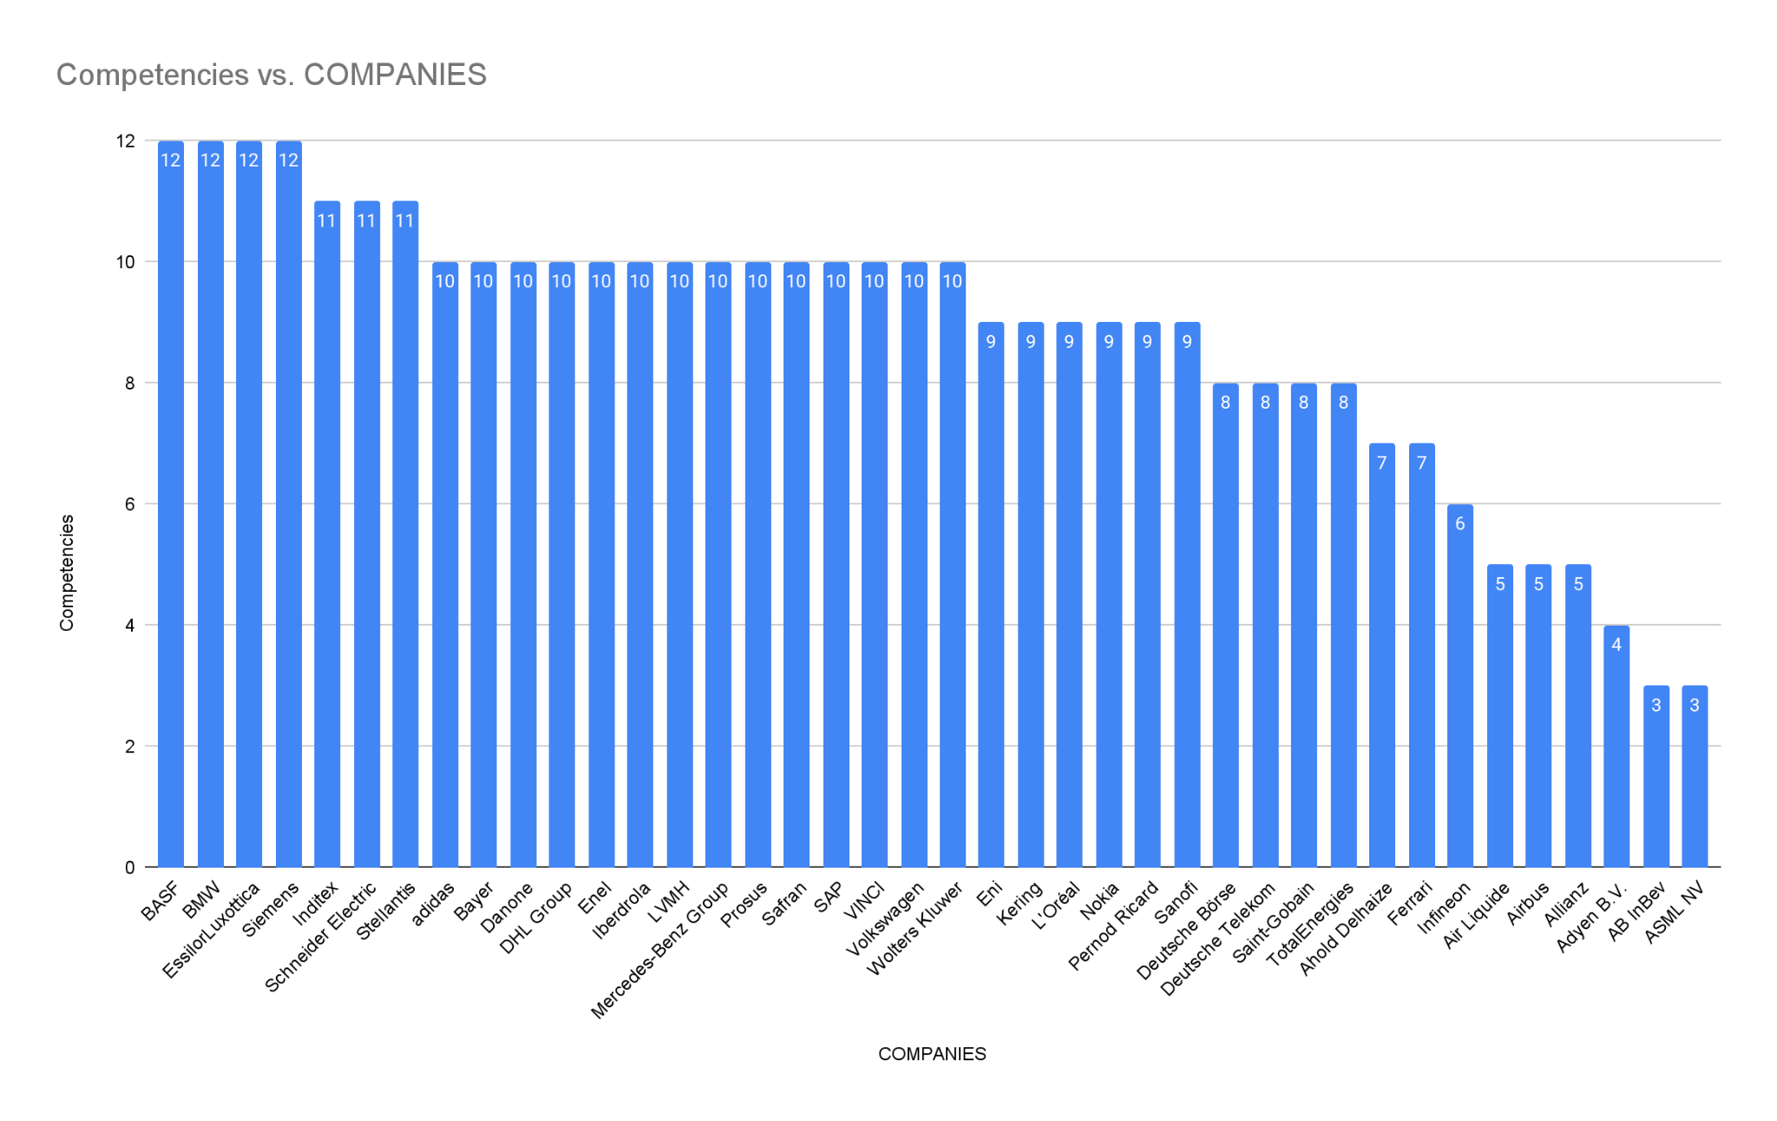
Board Competencies
Euro 50 Companies Competencies
Notes:
What was done.
To assess competency coverage at the company level for non-financial firms, a detailed count of how many distinct board-level competencies each company possesses was carried out. The process involved mapping the disclosed expertise of board members against a standardized list of non-financial competencies—such as Leadership & Governance, Strategy & M&A, Technology & Digital, ESG, HR & People, etc.—previously defined in the benchmarking framework. For each company, a count was recorded based on how many of these distinct competencies were present among its board members. This enabled us to measure the breadth of board skillsets and understand how comprehensively boards are equipped to handle evolving business environments.
Sample Used
The sample consisted of 100 non-financial companies spanning various sectors such as consumer goods, manufacturing, telecom, utilities, pharmaceuticals, and energy. These companies were selected from among the largest listed firms across multiple geographies, ensuring regional diversity and sectoral representation. They include globally recognized entities such as Nestlé, Siemens, L'Oréal, SAP, Vodafone, and BP, among others. Data was sourced from publicly available corporate governance reports, annual filings, and official board biographies. Only companies with full board data accessible in English or with credible translated sources were included in the final sample to ensure data reliability.
Assumptions Made
A few critical assumptions underpinned this analysis to ensure comparability across companies. First, each unique competency was counted only once per company, regardless of how many board members held it, thus emphasizing breadth over redundancy. Second, the competency framework used to evaluate the board composition was kept consistent across all companies and aligned with global best practices in governance benchmarking. Third, we assumed that publicly disclosed expertise accurately reflects actual board skillsets and that any omissions in disclosure were not competency-related. This provided a robust basis to benchmark how many strategic areas each board effectively covers, aiding in identifying leaders and laggards in governance diversity.

Slide 21
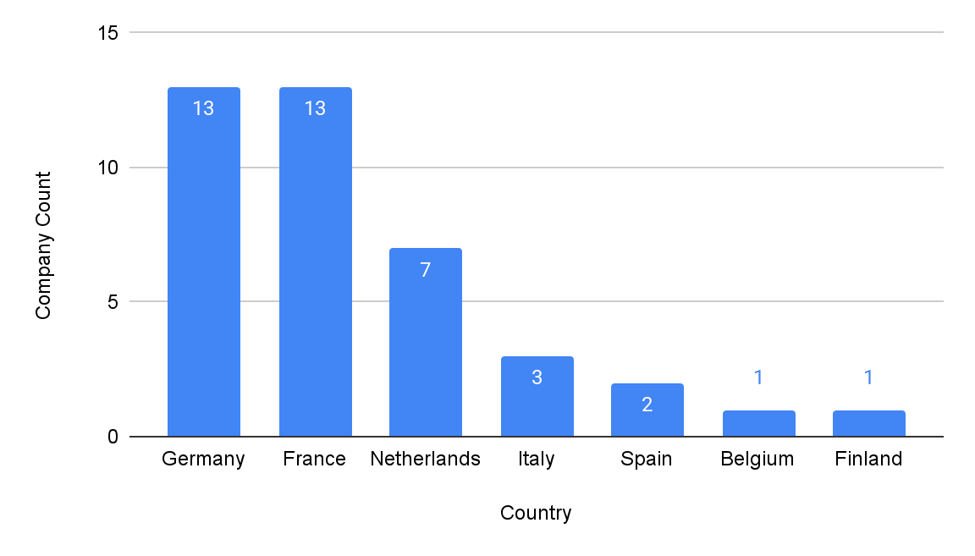
Euro 50 Companies Country
Country with 10+ Company: France, Germany
Notes:
What was done.
To assess competency coverage at the company level for non-financial firms, a detailed count of how many distinct board-level competencies each company possesses was carried out. The process involved mapping the disclosed expertise of board members against a standardized list of non-financial competencies—such as Leadership & Governance, Strategy & M&A, Technology & Digital, ESG, HR & People, etc.—previously defined in the benchmarking framework. For each company, a count was recorded based on how many of these distinct competencies were present among its board members. This enabled us to measure the breadth of board skillsets and understand how comprehensively boards are equipped to handle evolving business environments.
Sample Used
The sample consisted of 100 non-financial companies spanning various sectors such as consumer goods, manufacturing, telecom, utilities, pharmaceuticals, and energy. These companies were selected from among the largest listed firms across multiple geographies, ensuring regional diversity and sectoral representation. They include globally recognized entities such as Nestlé, Siemens, L'Oréal, SAP, Vodafone, and BP, among others. Data was sourced from publicly available corporate governance reports, annual filings, and official board biographies. Only companies with full board data accessible in English or with credible translated sources were included in the final sample to ensure data reliability.
Assumptions Made
A few critical assumptions underpinned this analysis to ensure comparability across companies. First, each unique competency was counted only once per company, regardless of how many board members held it, thus emphasizing breadth over redundancy. Second, the competency framework used to evaluate the board composition was kept consistent across all companies and aligned with global best practices in governance benchmarking. Third, we assumed that publicly disclosed expertise accurately reflects actual board skillsets and that any omissions in disclosure were not competency-related. This provided a robust basis to benchmark how many strategic areas each board effectively covers, aiding in identifying leaders and laggards in governance diversity.

Slide 22
Board Committees Analysis

Slide 23
Committee Benchmarking of Financial & Non Financial Companies
Audit | Nomination | Compensation | Sustainability | Strategy | Governance | Risk | Technology/Innovation | Personnel/HR | Executive | Finance | Other
Audit | Nomination | Compensation | Sustainability | Strategy | Corporate Governance | Risk | Technology | Personnel | Executive | Finance | Mediation
Audit & Risk | Appointments | Remuneration | ESG | Strategy & Sustainability | Governance & Ethics | Control and Risk | Innovation | Staff | Presidential | Finance and Investment | Conciliation
Audit and Compliance | Nomination and Compensation | HR and Remuneration | CSR | Strategy & CSR | Nomination and Governance | Risk Management | Innovation & Finance | People and Governance | General |  | Chairman’s
Finance & Audit | Nomination & Remuneration | Human Capital & Remuneration | Sustainability & Governance | Strategic | Governance Nomination & Sustainability | Legal Risk | Innovation Technology & Climate | Human Resources and Compensation |  |  | Chair’s and Corporate Governance
Performance Audit | Selection & Remuneration | Appointment & Compensation | Corporate Responsibility | Strategy and Sustainability | APPOINTMENTS AND CORPORATE GOVERNANCE |  | Technology and Digitalization |  |  |  | Chairman's/Nomination
Audit and Risk | Nomination and Succession |  | Safety and Sustainability |  | Nominations & Corporate Governance |  | Product and Technology |  |  |  | Related Parties
 |  |  | HEALTH, SAFETY & SUSTAINABILITY |  |  |  | Science |  |  |  | Stakeholders Relationship
 |  |  | CRSEC |  |  |  |  |  |  |  | Government Security
 |  |  |  |  |  |  |  |  |  |  | Legal Affairs
 |  |  |  |  |  |  |  |  |  |  | Supervisory
 |  |  |  |  |  |  |  |  |  |  | Investment
 |  |  |  |  |  |  |  |  |  |  | Digital

Slide 24
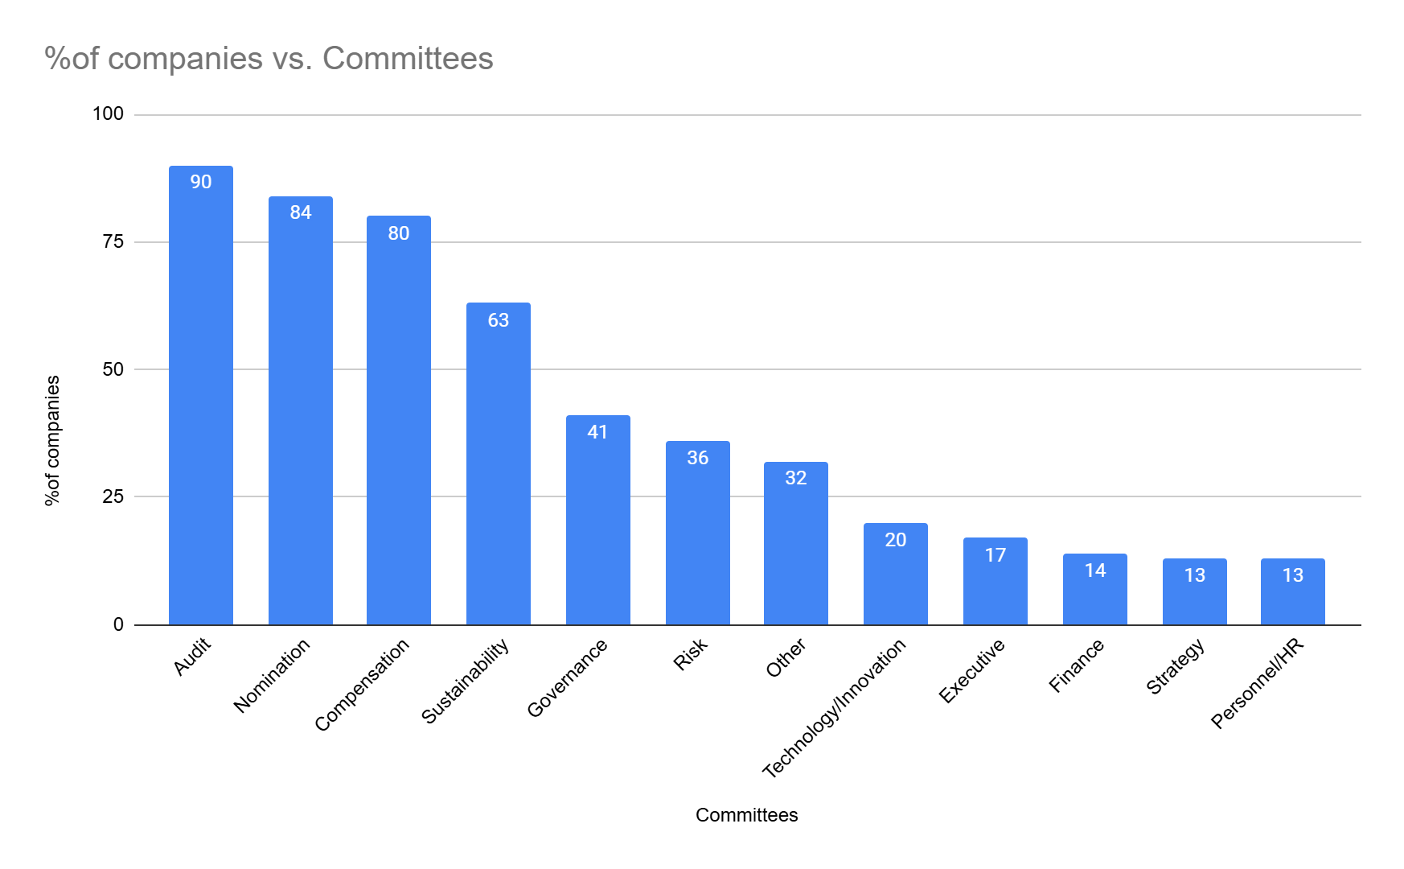
Board Committees
Non Financial Companies Committees
Notes:
What we did:
We conducted an analysis of non-financial board committees to determine how commonly they appear across company boards. The objective was to gain insight into the prevalence and prioritization of various non-financial governance functions.
Sample used:
The study was conducted using a sample of 100 companies. Each company was evaluated for the presence of 12 predefined non-financial board committees.
Committees considered:
Audit, Nomination, Compensation, Sustainability, Strategy, Governance, Risk, Technology/Innovation, Personnel/HR, Executive, Finance, Other
Any assumptions made:
Each company could have multiple committees.
The presence of a committee was recorded as binary (i.e., either present or absent—no weighting or scaling applied).
The "Other" category includes any additional committees that did not fit the predefined list.
Key Observations from Results:
The most prevalent committees are Audit (90%), Nomination (84%), and Compensation (80%).
Sustainability committees (63%) also show a strong presence, indicating growing ESG focus.
Less common committees include Governance (41%), Executive (17%), and Personnel/HR (213).
These insights suggest that while compliance and oversight-related committees are nearly universal, strategic and innovation-related committees are still evolving in board structures.

Slide 25
13 HR Committees List
BASF
BMW
Deutsche Telekom
DHL Group
Nokia
Prosus
SAP
BP
BHP
Imperial Brands
The Navigator Company
CNH Industrial
National Grid

Slide 26
Board Committees
Non Financial Companies Committees
Notes:
What we did: In this analysis, we examined the number of board committees for each company in our dataset, which includes around 100 companies from various sectors and regions. Committee presence was counted on a binary basis, with a value of 1 representing the existence of a committee. The chart indicates that the number of committees per company ranges from 1 to 10. Companies like Unilever, Vodafone, and SAP show relatively higher counts of committees, while firms such as Ferrari and BAT have fewer committees. The majority of companies fall within the 3 to 7 committee range.

Slide 27
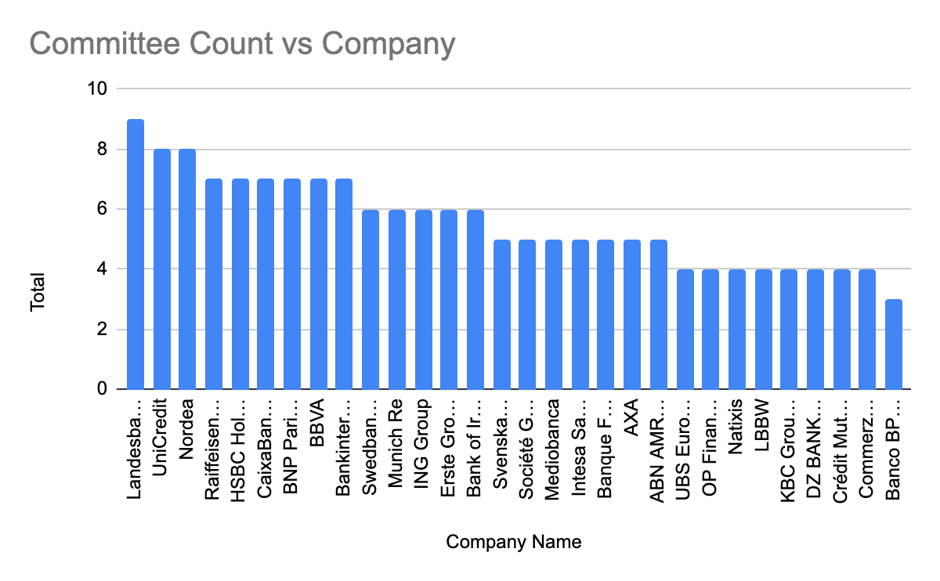
Board Committees
Financial Companies Committees
Notes:
In this analysis, we examined the number of financial board committees for each company in our dataset, which consists of 34 financial companies. The presence of committees was counted on a binary basis, with a value of 1 representing the existence of a committee. The chart reveals that the number of financial committees for these companies ranges from 2 to 8. Notably, companies like Raiffeisen Bank International, Erste Group, BNP Paribas, and Unicredit exhibit a relatively higher number of committees, while firms such as AXA and Crédit Mutuel Arkéa have fewer committees. The majority of the companies fall within the 4 to 6 committee range.

Slide 28
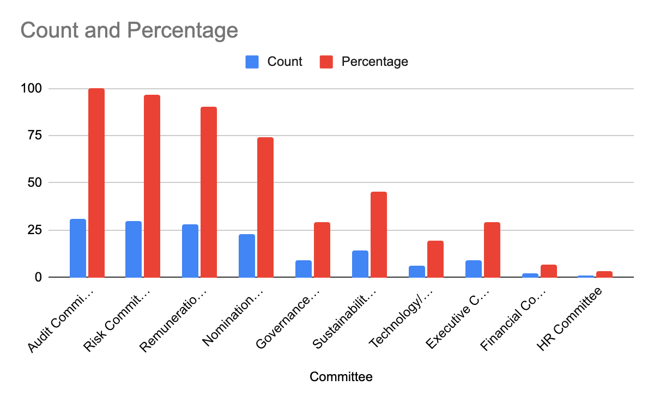
Board Committees
Financial Companies Committees
Notes:
What we did: We analyzed the presence of specific board committees across 34 financial companies, capturing both the absolute count and percentage presence of each committee type.
Sample used: 31 financial companies.
Assumptions:
Each committee was counted once per company (binary presence).
Committee-wise Insights (% of companies having them):
Risk Committee: Present in 96.97% of companies (32 companies)
Audit: Present in 87.88% (29 companies)
Compensation: Present in 87.88% (29 companies)
Nomination: Present in 72.73% (24 companies)
Sustainability: Present in 36.36% (12 companies)
Other (unspecified/unique committees): Present in 36.36% (12 companies)
Executive: Present in 33.33% (11 companies)
Governance: Present in 27.27% (9 companies)
Technology/Innovation: Present in 21.21% (7 companies)
Personnel/HR: Present in 9.09% (3 companies)
Finance Committee: Present in 13.03% (likely 4-5 companies)

Slide 29
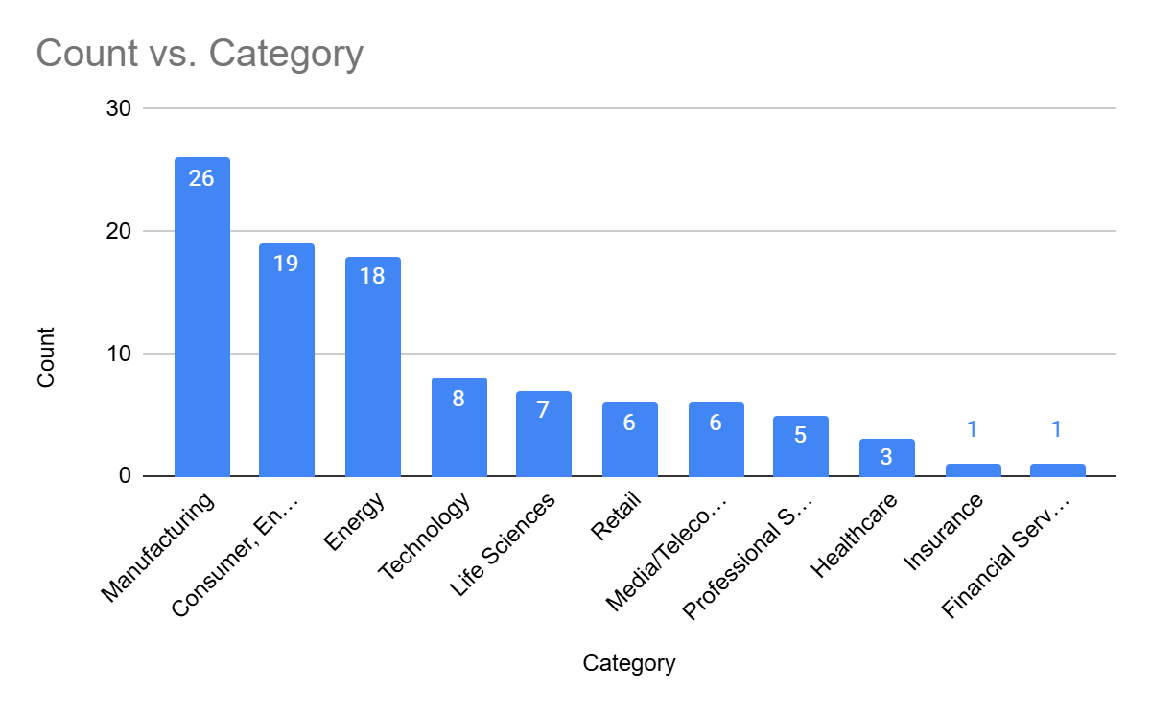
Industry Category of 100 Non Financials Institutions
Notes:
The chart titled "Industry Category" illustrates the industry-wise distribution of the 100 non financials companies studied. These companies were grouped based on their primary industry classification to understand sectoral representation across the selected sample. The purpose of this analysis was to assess which industries are most represented among major European firms, many of which are part of the EURO STOXX 50 index, providing insights into where boardroom representation is concentrated.
The companies were categorized according to standard industry sectors, such as Financial Services, Manufacturing, Consumer & Entertainment, and Energy, among others. Each company was counted once under its dominant industry classification. This classification assumes that the primary industry of operation best reflects the context of corporate governance and board structure, and no weighting was applied based on revenue or market capitalization. The chart is a simple count-based representation, offering a snapshot of how different industries contribute to the overall composition of the analyzed firms.

Slide 30
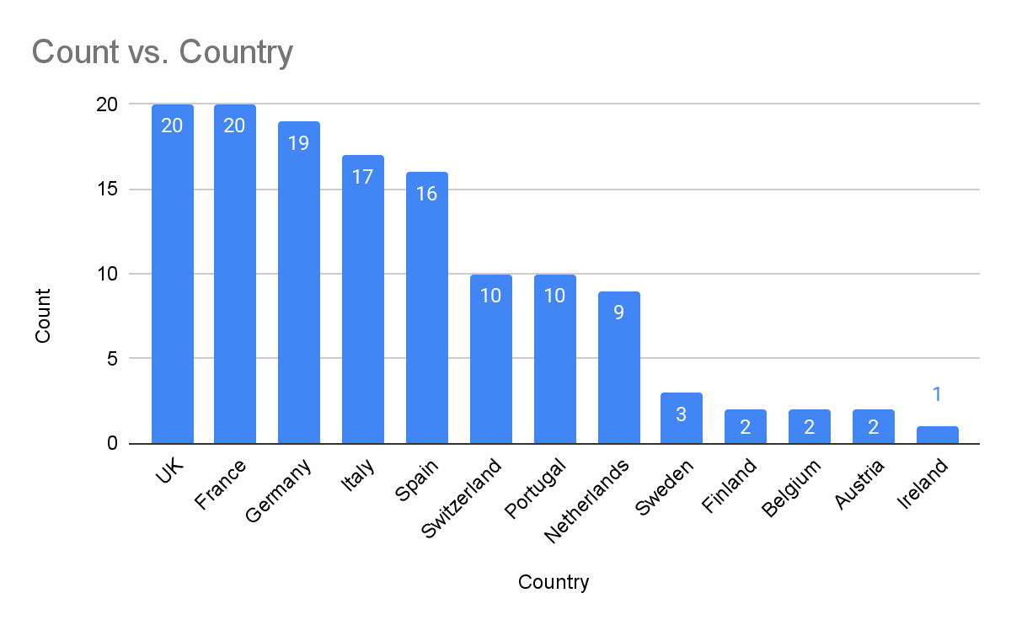
Country (Both financials & Non Financials Combined)
Countries with 10+ Companies in sample: France, Spain, Italy, Germany,UK
Notes:
The chart titled "Country (Both Financials & Non-Financials Combined)" presents the distribution of company headquarters across European countries, based on a sample of 130 firms—comprising 30 financial and 100 non-financial companies, many of which are constituents of the EURO STOXX 50 index. The count for each country reflects the number of companies headquartered there, providing a snapshot of corporate presence and influence in the European economic landscape.
To generate this visualization, companies were mapped to their registered headquarters, treating this location as a proxy for country-level representation. The sample included major firms from both sectors to ensure a balanced view of corporate presence. No weighting was applied based on company size or board structure; each entity contributed equally to the count. This approach assumes that the headquarter location effectively reflects a country’s corporate footprint, without considering operational scale or global reach.
Key insights show that France, the UK, and Germany dominate with 20, 20, and 19 company headquarters, respectively—highlighting their central roles in European finance and industry. Southern European economies like Italy (17) and Spain (16) also show robust representation. Meanwhile, smaller economies such as Ireland, Austria, and Finland register lower counts, possibly due to more limited capital markets or large-cap firm presence. This chart offers a foundational understanding of how company headquarters—and by extension, board compositions—are geographically distributed across Europe.

